Slide 1
What do you get when you cross a High School Teacher with a Community College Instructor?
By
Jody Derry
Allan Hancock College

Slide 2
Agenda
Explain Programs of Study Project
  Industry Sectors
  Developing Programs of Study
  Information Technology Example
  Benefits of Working together
Industry Sector Bulletin Board Kit
  The RIASEC Test
  Setting up your Bulletin Board
  Additional Kits at Booth 319

Slide 3
Why, What, Where
Ed Code 51228
  Each school district maintaining grades 7 to 12, shall offer a course of study that provides an opportunity for those pupils to attain entry-level employment skills in business or industry
Programs of Study
  A multi-year sequence of academic and technical courses toward a specified career area
15 Industry Sectors
58 Career Pathways
Unlimited Programs
of Study

Slide 4
Program of Study Template
Industry Sector & Pathway
  Recommended schedule from 7th Grade through college
  Worked as a team to develop
  Used the Career Technical Education Model Curriculum Standards
    Matched standards to course objectives
  Findings
    Needed to add 2 courses to the program at Community College
    Strengthened the connection between the high school and college
    Validated articulated courses
POS Excel Template
POS Word Template

Slide 5



Resources
Developing Programs of Study Booklet
Program of Study Template
High School & College Teachers
Community
Advisory Teams
Contact Persons on back of Programs of Study Booklet
California Department of Education Website
www.cde.ca.gov

Slide 6

Bulletin Board Kit
The RIASEC Test
Bulletin Board Example
Setting up your Bulletin Board
  Changing the industries, keeping it fresh

Slide 7
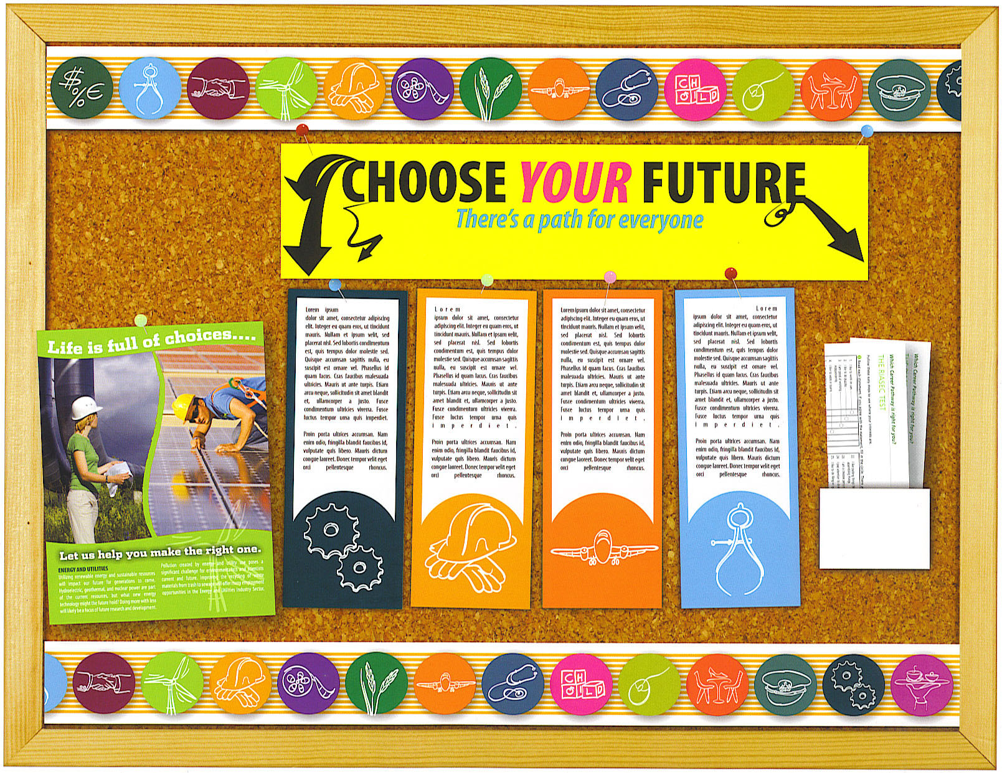

Slide 8
Thank you for your time.
I hope you the information was helpful.
You can receive additional
Bulletin Board Kits
at Booth 319.

